Slide 1
Hack-a-Tips
The keys to success at a hackathon

Slide 2

Our Objectives
Provide you with strategies to combat organizational and management problems that teams often encounter.
Point you to resources that can kick start your development efforts to get you off the ground quickly and give you time to focus on important things.

Slide 3
Working as a Team
A lot of teams struggle during hackathons. You can easily spot the dysfunctional teams, because they frequently say things like this...

Slide 4

"I don't know where to begin..."

Slide 5

"I just want to get coding already!"

Slide 6
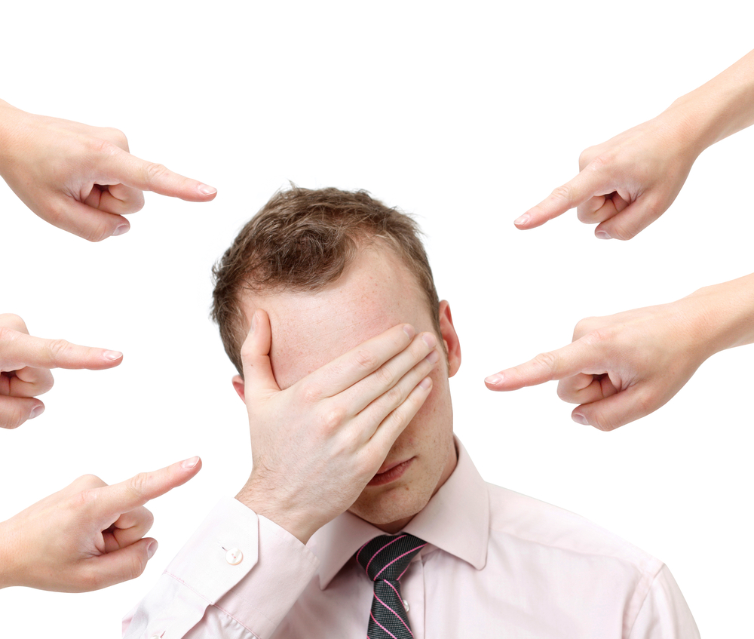
"I thought you were doing that!"

Slide 7

"I'm out..."

Slide 8
Most of these issues boil down to two things :
Poor organization
Poor management
Plan your work. Work your plan.

Slide 9
Containing the Scope

Slide 10
Define your problem
Write a problem statement - a brief description of the issue(s) to be addressed
It aids in defining the scope of work to be tackled during the evening by setting some sane "boundaries", and helps ensure that everyone is on the same page
A good problem statement is made up of 4 components
Description - A clear, specific overview of the "current state"
Impacts - What exactly is impacted by the problem and how
Success Criteria - How exactly will you know you have solved the problem
Constraints - Impediments to solving the problem that must be overcome
Be careful not to jump straight to solutions yet!

Slide 11
Organize your team
Pick a leader that will speak on behalf of the team – settle disputes, remove roadblocks and set direction
The best coder doesn't necessarily make the best leader
A time/scope wrangler that will keep you on task and on time
One person can serve in multiple roles, so don't limit yourself
Decide how often you should regroup

Slide 12
Organize your work with Kanban
Kanban is an agile method for visually managing work. This approach presents all participants with a full view of the development process from task definition to delivery. It allows us to balance the demand for work to be done with the available capacity to start new work.

Slide 13
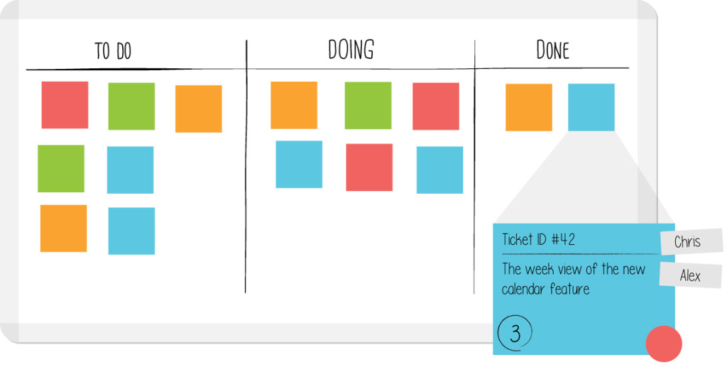
Kanban Board

Slide 14
Now we have a solid attack plan, let's get coding!

Slide 15
Using your Time Wisely
Ask questions and don't be afraid to ask for help.
Speak up if you don't agree with something.
Do your homework and learn on the fly.
Don't use technology {x} for the sake of using it; use the right tool for the job.
Don't be afraid to fail. But fail fast. Move on.

Slide 16
Kick-starting this Thing
Pick your tools
Whatever you do, don't try to do it from scratch unless you really know what you are doing. Even then, you'll still be pressed for time. You can get up and running quickly, easily, and securely, by using common tools and frameworks.
No idea where to start? No idea which is better at {thing}? Ask your friendly neighborhood Mentor! Or, take a look at what the broader community thinks...

Slide 17
Find a framework for…
Java
Python
PHP
Perl
JavaScript
HTML/CSS
etc
Notes:
Hotframeworks.com is a good resource

Slide 18
Presentation Tips
Don’t neglect the presentation! It’s just as important as the code you’ve written.
Slides are better than nothing. Talking is better than just slides. A demo is a million times better than both.
Practice makes perfect. Set aside at least one hour for your whole team to practice presenting your elevator pitch
Know your audience - Your company doesn’t care that you used Super-Fancy-Widget. They care that it solves their problems.
Good feature ideas you haven’t implemented yet? Write it down! (Hint: Look at your Kanban board for features you dropped)
Be Honest - all the features aren’t there, or your app is broken because you ran out of time? Tell them!

